Slide 1
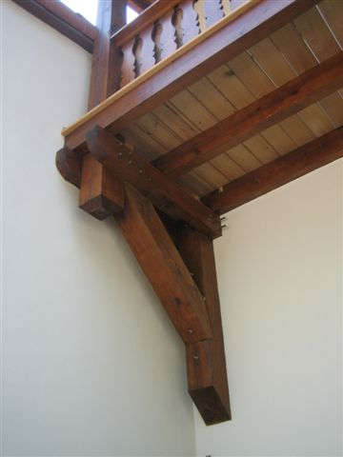
SATILLA, INC.

Slide 2
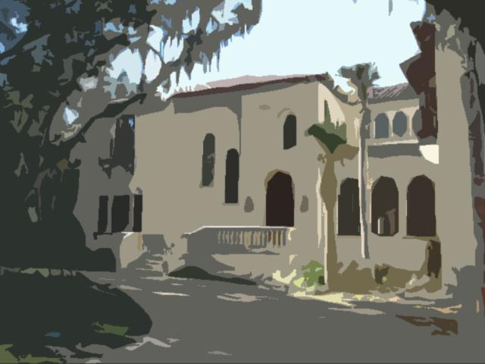
BRAD WALTERS: Mr. Walters started his career in the construction industry while in high school as a carpenter's helper during the summers and worked in many areas of the construction industry until he formed Satilla, Inc. in 2004. Based on Mr. Walters' experiences and interests he decided to create a company that delivered creative, high quality work at a good value to its clients. Since the company's inception Satilla has built projects in Sea Island, Georgia and in Jacksonville, Florida. These projects have ranged in value from five million dollars to a few thousand dollars. This value range is illustrative of the company's desire to serve its clients needs regardless of the scope of the work. Mr. Walters is a Certified Building Contractor and attended both the University of Georgia and Georgia State University where he studied history. Satilla's office was awarded "Best Renovation" by Riverside Avondale Preservation in 2009.

Slide 3

STEWART GREEN: Mr. Green started his construction experience as a laborer when he was 15 working as a carpenter through high-school and college, eventually finding a place in field management to work from foreman to superintendent. Mr. Green has managed $200M A+++ offices, selected tenant build-outs and high-end residential homes, following clients in projects of character and performance. Mr. Green is a Certified General Contractor, Certified LEED Associate and has 2 degrees in Construction Management from Roebuck & Associates. Mr. Green graduated from Washington & Lee University with a second degree from the University of North Florida in Construction Management.

Slide 4
Satilla, Inc.
The intent is to create, not build. While it may be said that a good architect can get an original design into budget, we believe a good builder can build a building to suite both the intent of the owner and the character of the design. And all while establishing, verifying and buying out a budget so there are no surprises.

Slide 5
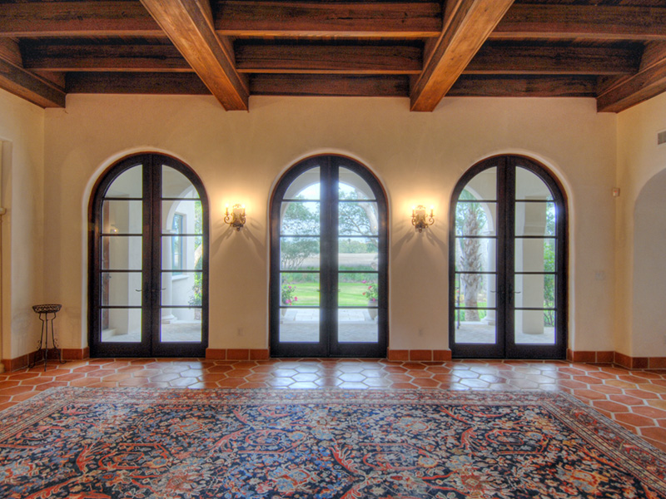
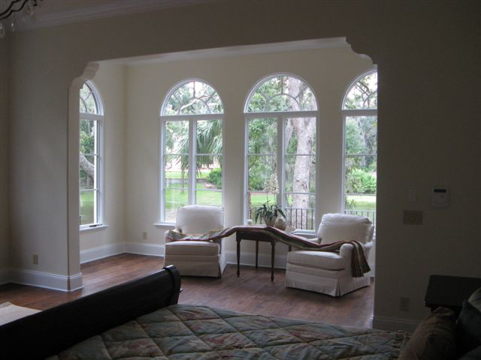

Slide 6
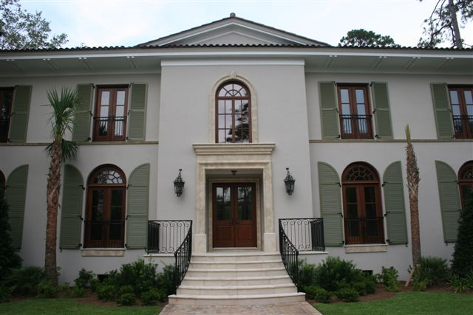
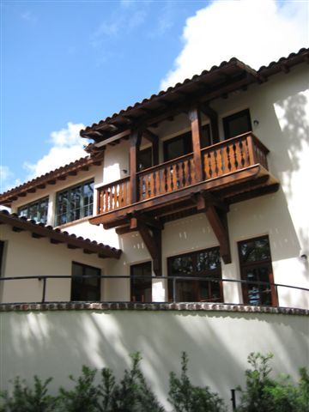

Slide 7
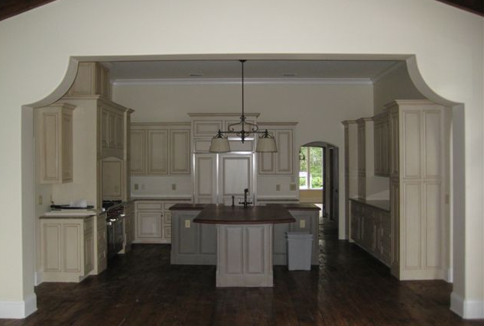
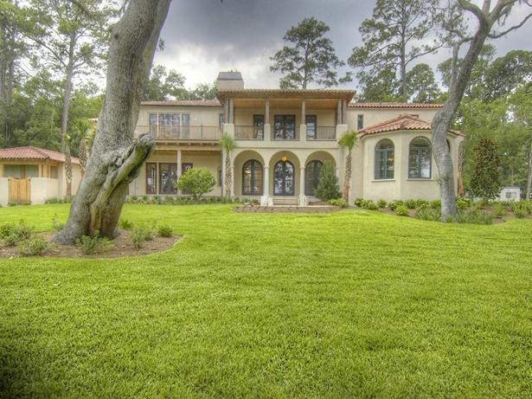

Slide 8
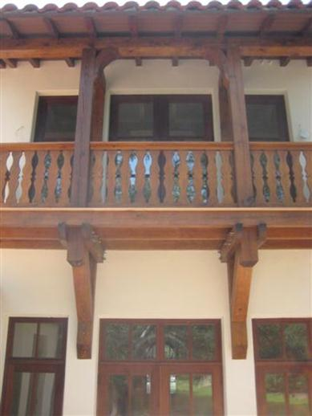
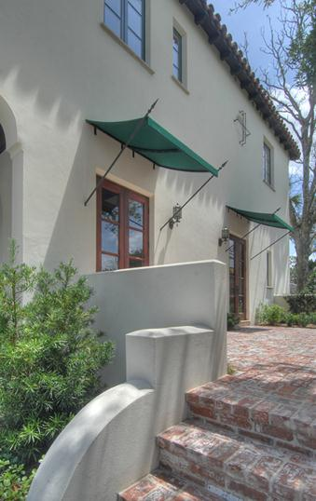
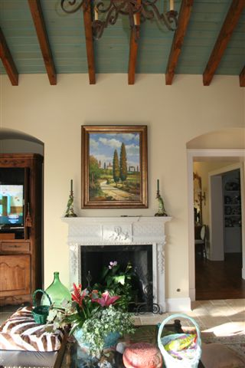

Slide 9
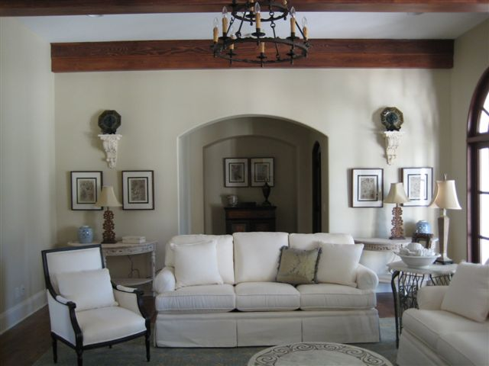
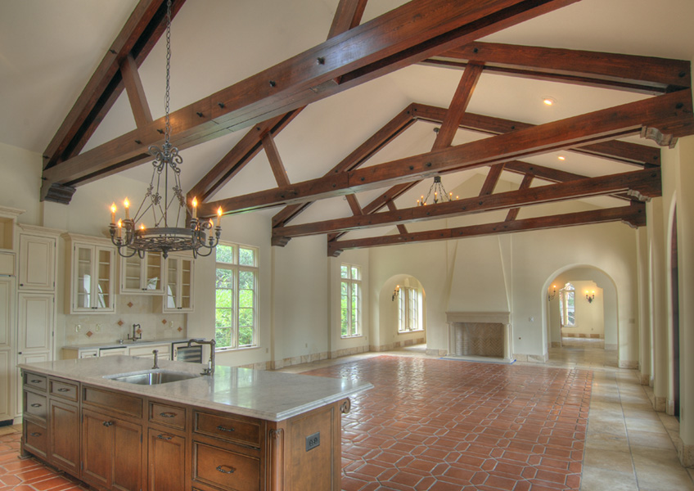
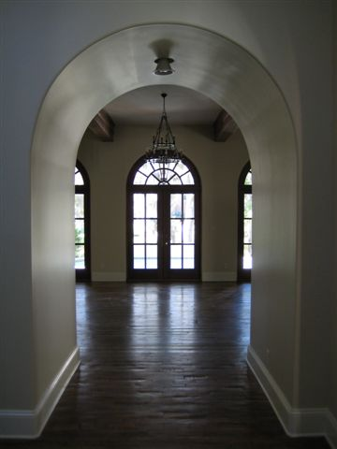

Slide 10
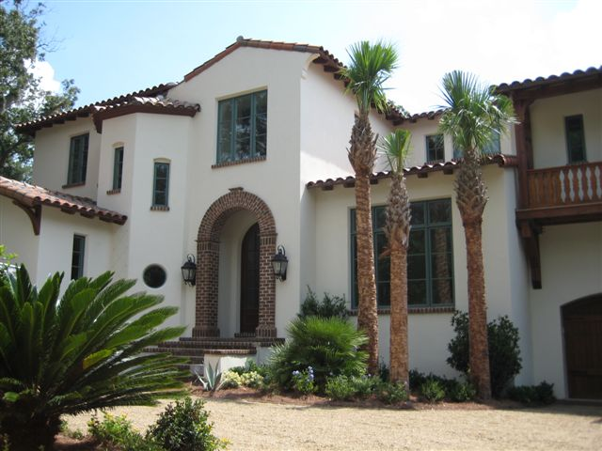
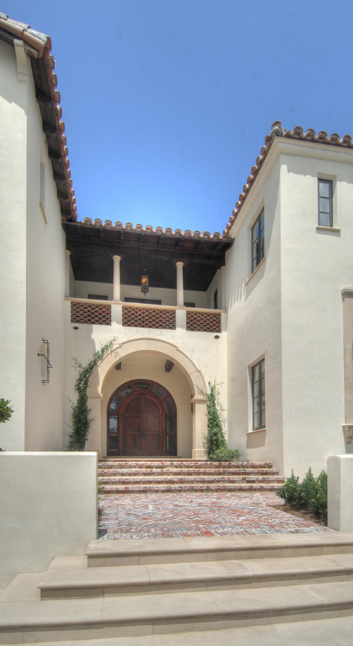
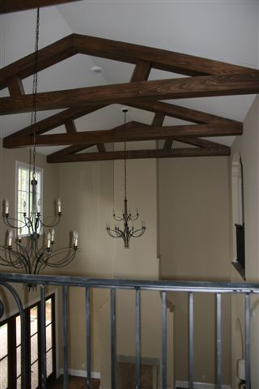
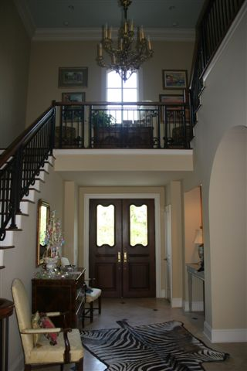

Slide 11
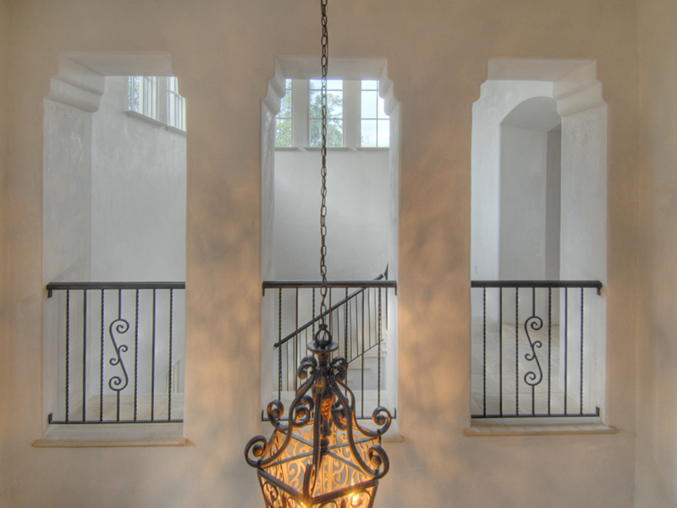
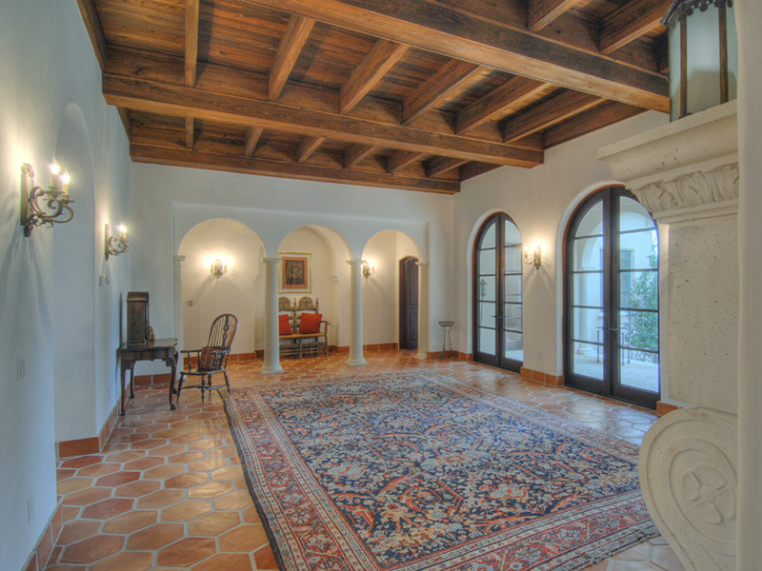
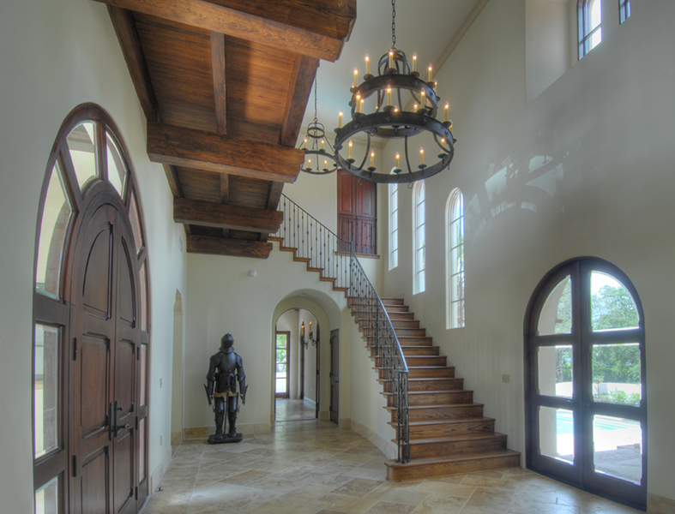

Slide 12
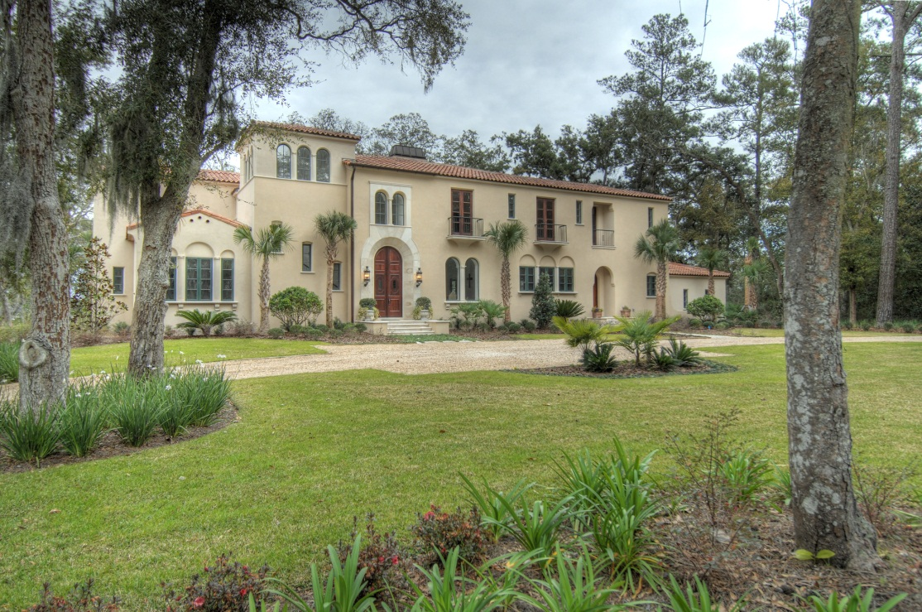
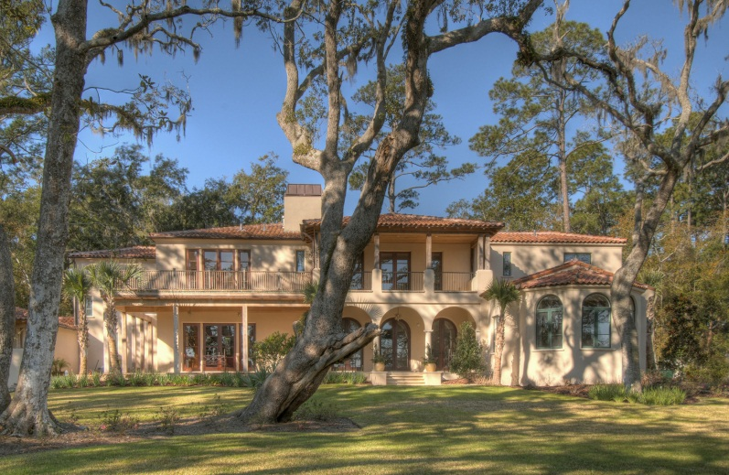
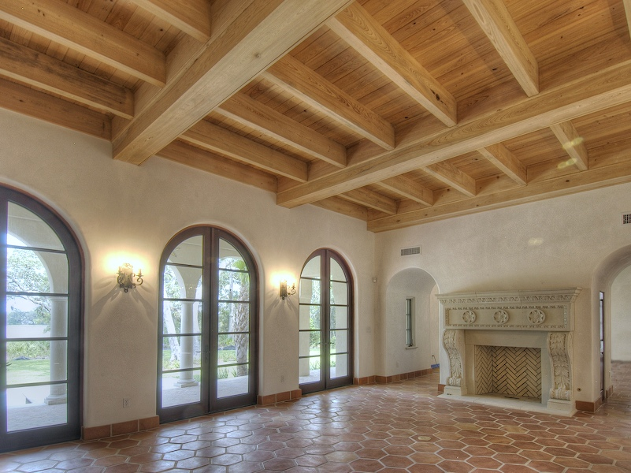
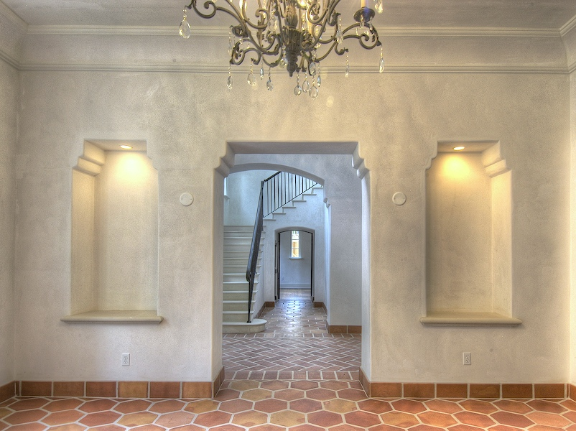

Slide 13
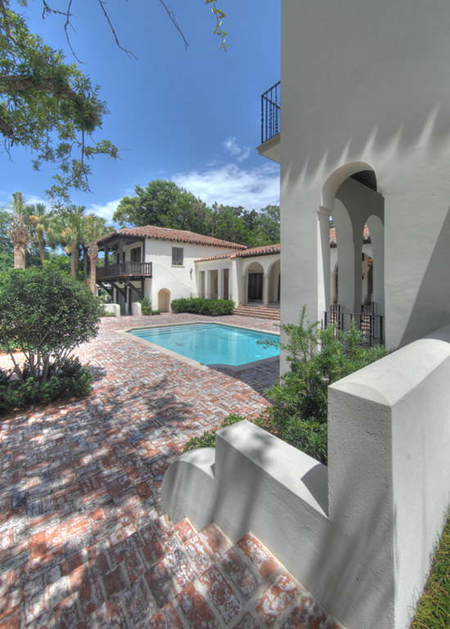
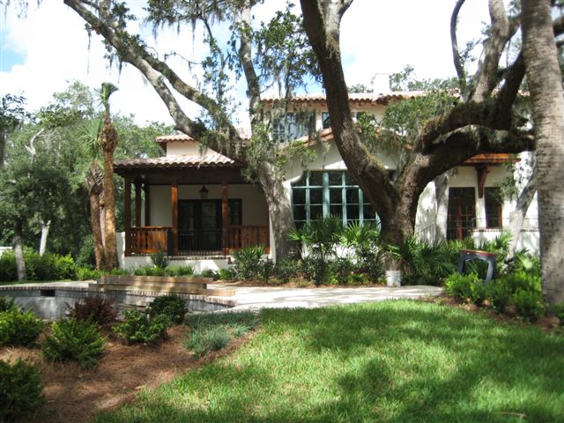
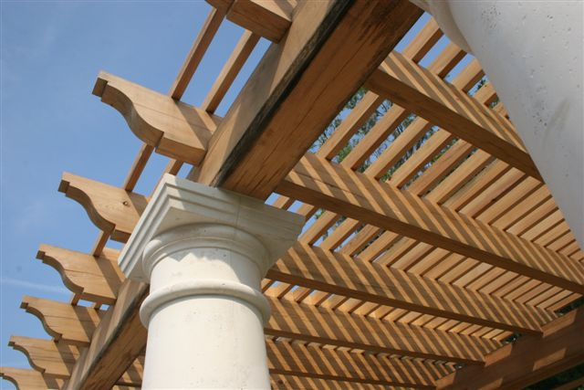

Slide 14
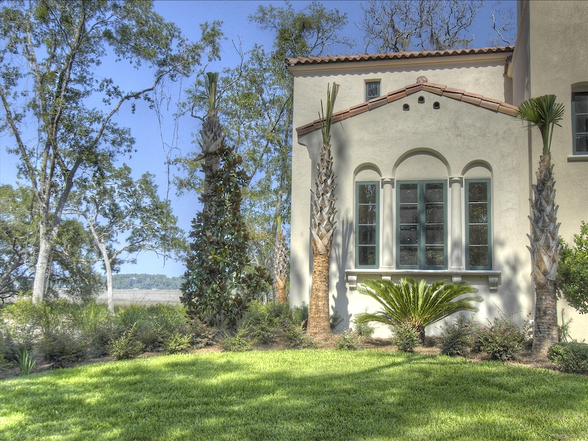
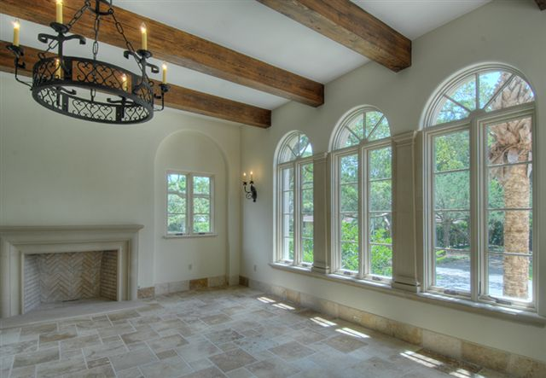
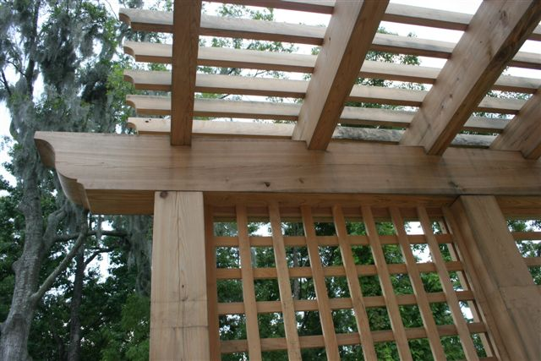
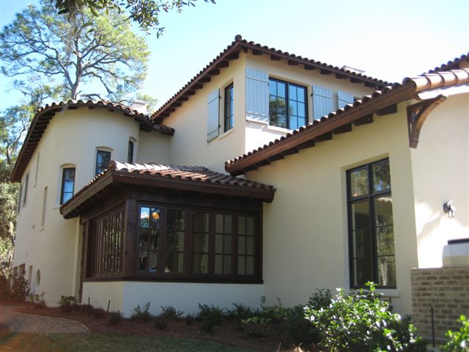

Slide 15
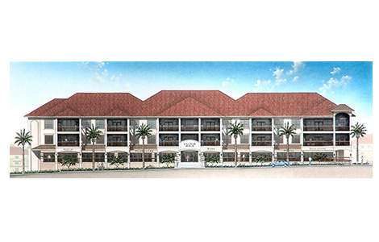
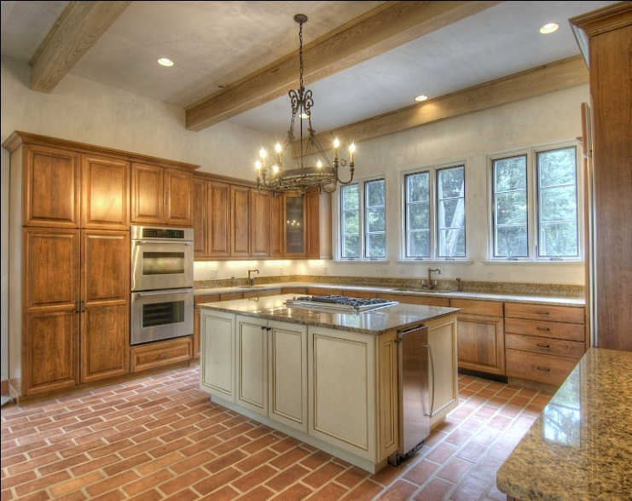
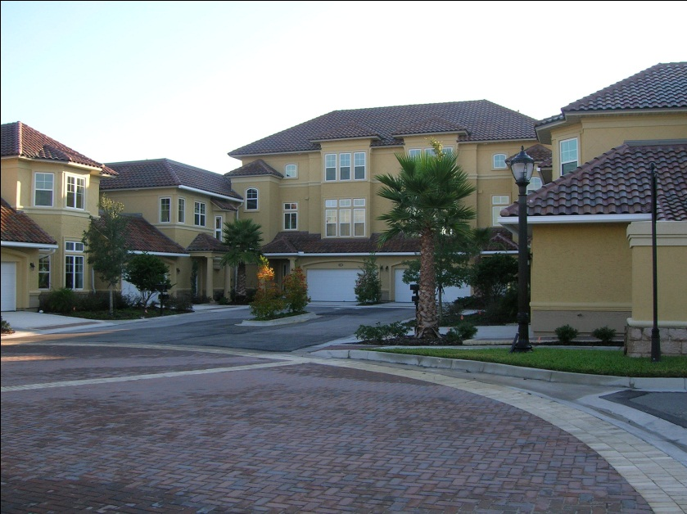
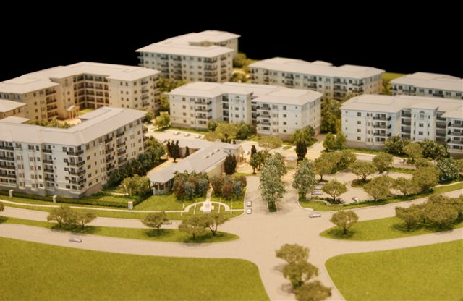

Slide 16
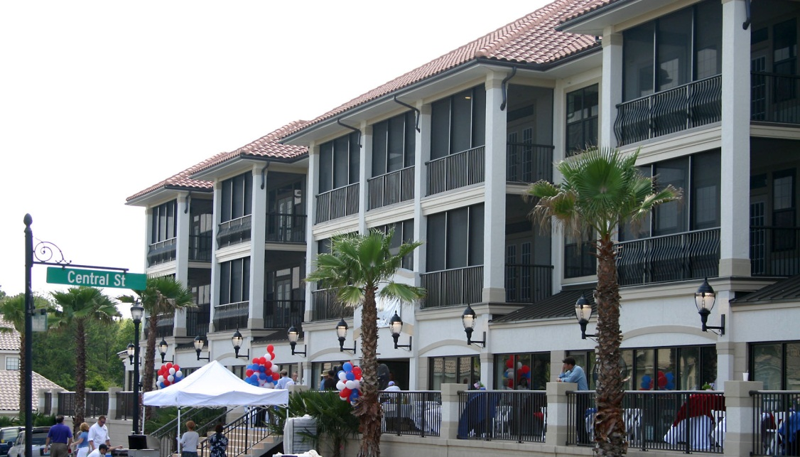
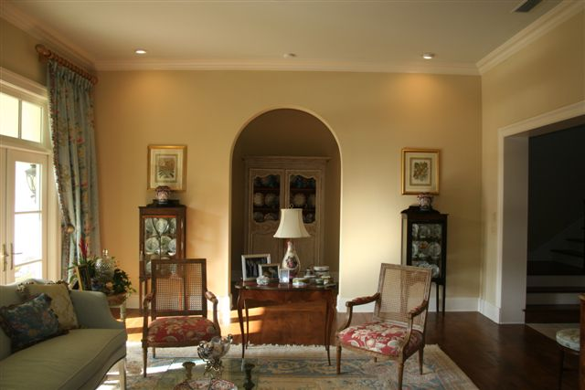
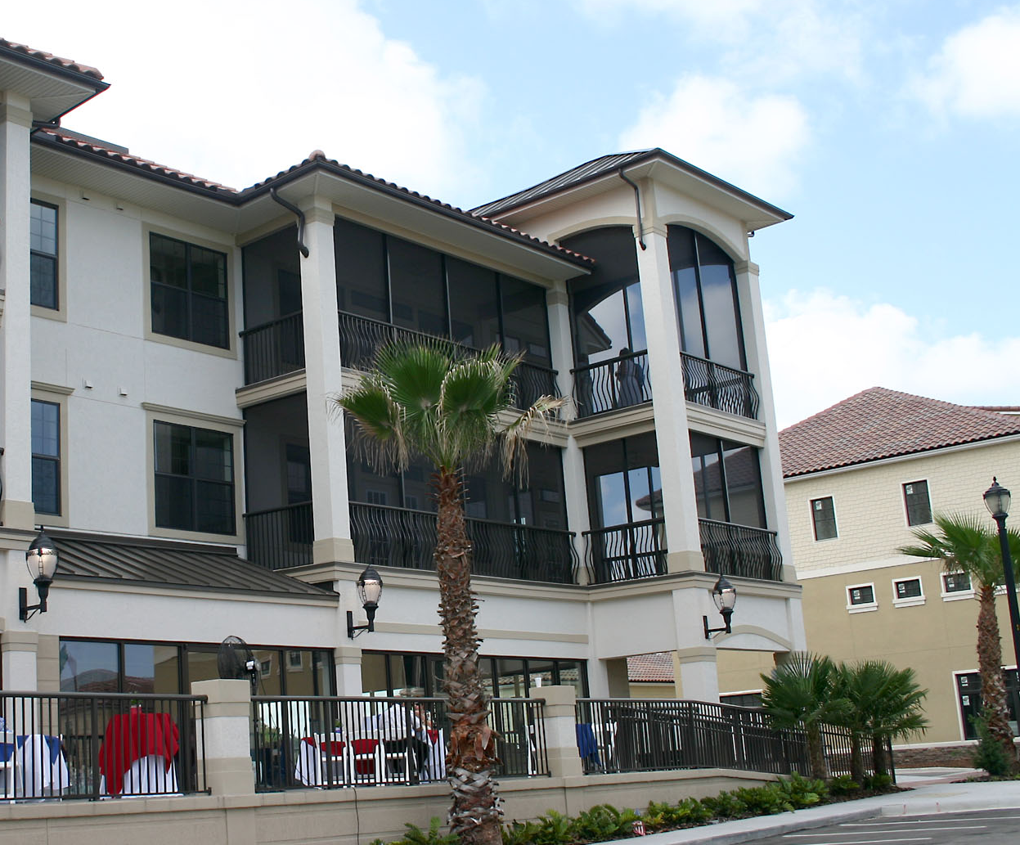
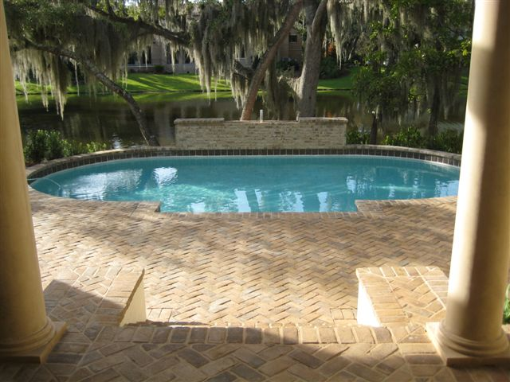

Slide 17


SATILLA, INC.
2742 HERSCHEL ST.
JACKSONVILLE, FL 32205
904.389.3704
904.389.3805 fx

